Slide 1
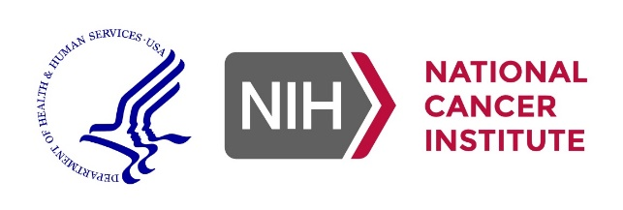
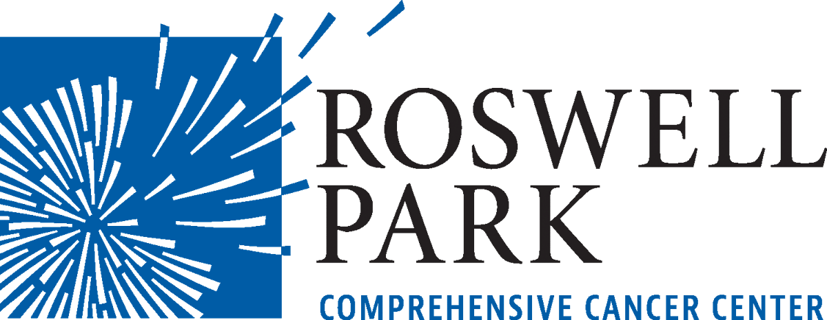
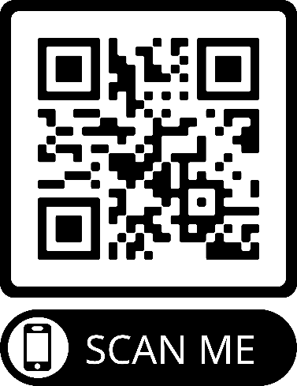
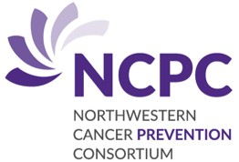
Are you a former smoker?
If you would like to learn more about this study, please contact the study coordinators:
Roswell Park Comprehensive Cancer Center
Bridget Fleissner
Bridget.Fleissner@RoswellPark.org
716-845-1300 extension 7830
Rocky Mountain Regional VA Medical Center
Michele Baloneque Siqueira
michele.balonequesiqueira@cuanschutz.edu
303-724-1662
University of British Columbia, BC Cancer Research Centre
Sukhinder Khattra
skhattra@bccancer.bc.ca
604-675-8089
NWU20-04-01
Join a study
on Lung Cancer Prevention
Testing Metformin to lower lung cancer risk in high-risk individuals
Advances in cancer prevention rely on people at risk for cancer, who participate in clinical trials.
Will you join us in the pursuit to prevent cancer?
Scan this code with your smartphone’s camera, or visit
nucancerprevention.org to learn more.
NWU20-04-01 Yendamuri Metformin Brochure Version 1.0, 01/05/2022

Slide 2
You may be eligible if:
If you take part in this study, you will be asked to do the following:
You are a former smoker and have quit at least12 months prior to enrollment.
You are overweight (BMI greater than or equal to 25) with no prior diagnosis of Diabetes Mellitus (DM1 or DM2)
You have not used Metformin within the past 2 years
You will have a bronchoscopy which is a medical procedure to look into your lungs.
You will be randomly placed in one of two groups.
Group 1 will take up to 2000 mg of Metformin by mouth once a day for up to 26 weeks, and then have a second bronchoscopy.
Group 2 will wait 26 weeks, then have second bronchoscopy. Then take up to 2000 mg of Metformin by mouth once a day for up to 26 weeks, and then have a third bronchoscopy.
Receive phone calls or emails from the study team to monitor your health.
Keep a pill diary to help you keep track of when you take your pills and to share with the study coordinator.
You will receive $50 for each non-bronchoscopy study visit and $100 for each bronchoscopy study visit for your time, transportation, parking, and other expenses related to the study.
Why is this study being done?
Patients who have stopped smoking continue to be at risk for the development of lung cancer.
To find out if Metformin might protect former smokers who are overweight from developing lung cancer.
Lung cancer is the second most common cancer and accounts for the most cancer-related deaths.
Note: Metformin is a medication that is commonly used and FDA approved to treat Diabetes Mellitus since 1995 in the USA.
Joining this study is entirely voluntary. If you are interested in participating or have additional questions, please talk to your doctor or contact a study coordinator.
At

